Slide 1
It’s time to rock!!!

Slide 2
Part 6: Phrases and idioms
-faith departed:
-open highway:
-stood their ground:
-back down:
-make your own breaks:
-calling you out:
-stand tall:
缺乏信念(的人)
開放的公路
堅強(的人)
認錯；認輸；屈服
遭遇挫折
(有人)向你挑戰
拿出勇氣；勇於面對

Slide 3
2
6
10
7
5
4
1
8
3
9

Slide 8
messy

Slide 9
neat

Slide 10
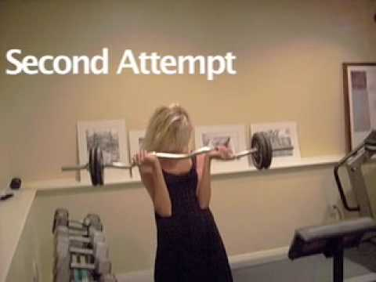
weak

Slide 11
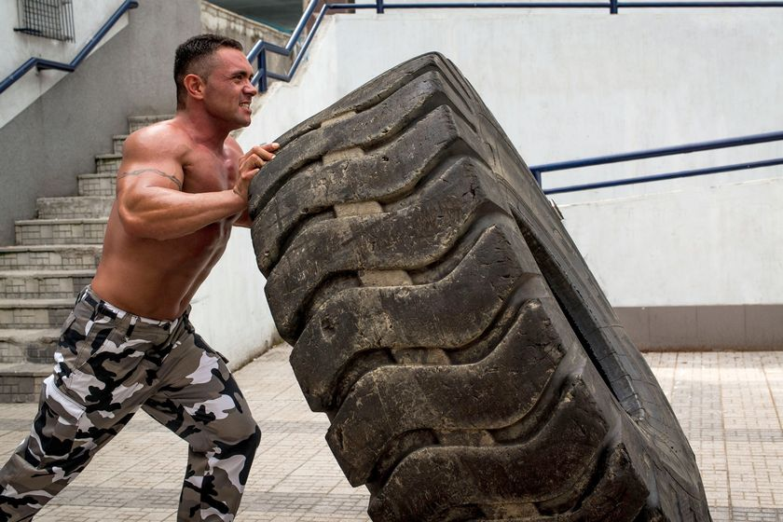
strong

Slide 12
young

Slide 13
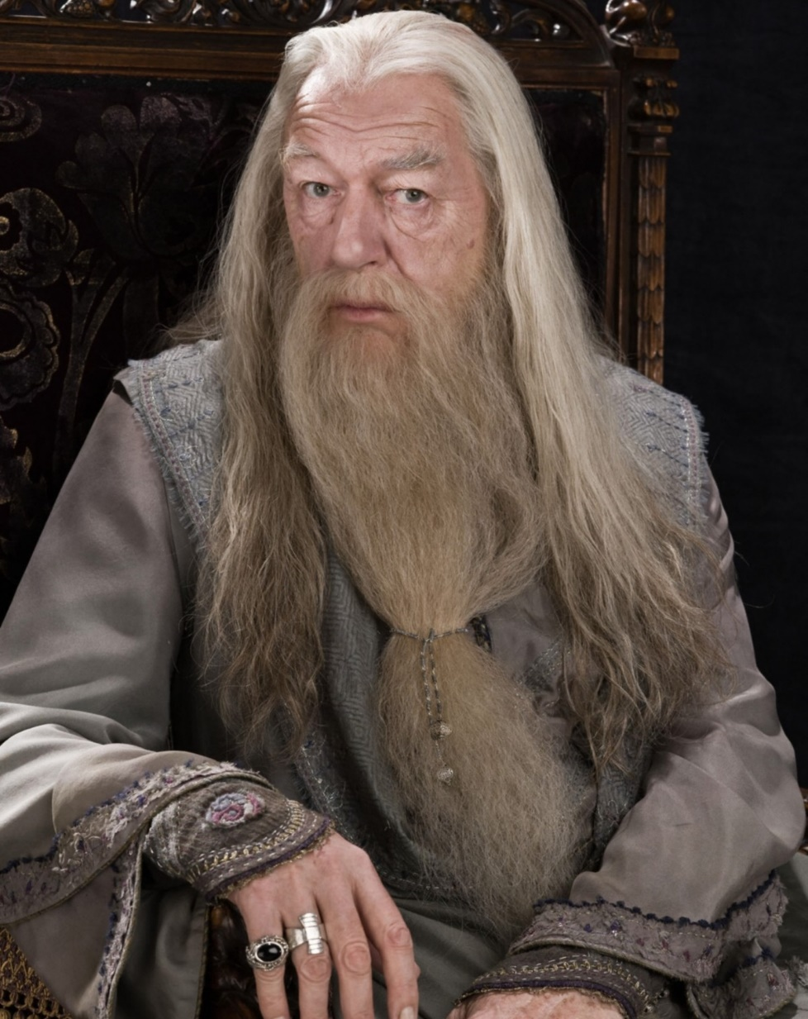
old

Slide 14
shy

Slide 15
outgoing

Slide 16
messy and neat

Slide 17
weak and strong

Slide 18
young and old

Slide 19
shy and outgoing

